Slide 1
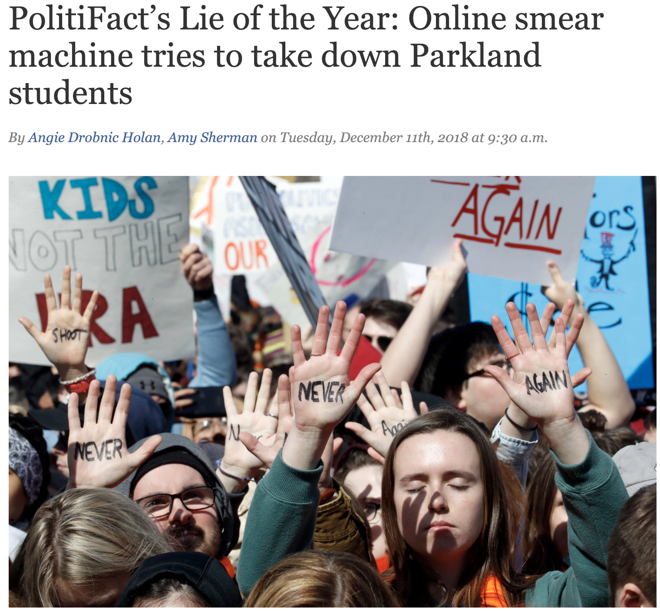
UC Berkeley’s CS61A – Lecture 04 – Higher-Order Functions
YouTube says it will crack down on recommending conspiracy videos www.cnn.com/2019/01/25/tech/youtube-conspiracy-video-recommendations
“YouTube would start reducing its recommendations of ‘borderline content’ (e.g., videos featuring fake miracle cures for serious diseases, claiming the earth is flat and making blatantly false claims about historic events such as 9/11) and videos that may misinform users in ‘harmful ways.’ Such content doesn't violate YouTube's community guidelines, but the company says it comes close. (It would apply to less than 1% of content on its platform)
YouTube has long faced criticism for allowing misinformation, conspiracy theories and extremist views to spread on its platform, and for recommending such content to users. People who came to the site to watch videos on innocuous subjects, or to see mainstream news, have been pushed toward increasingly fringe and conspiracist content.
For example, after a mass shooting at a high school in Parkland, Florida last year, a top trending video on YouTube suggested survivor David Hogg was an actor.”

Slide 2
Announcements
Lab 00 is a take-home lab. Try to complete it before your lab this week.
Homework 1 is released and is due this Thursday 1/31 @ 11:59pm.
Drop-in office hours start this week.
Extra lectures (optional, on Additional Topics) start this week, Wednesdays 1-2pm in Soda 310: https://cs61a.org/extra.html
Hog has been released! Entire project due Thursday 2/7
Solve Phase 1 individually; Work with a partner on Phases 2 & 3.
Phase 1 checkpoint due Tuesday 2/5.
Submit everything by Wednesday 2/6 for an early submission bonus point.
Project Party next Monday 2/4.

Slide 3
Iteration

Slide 4
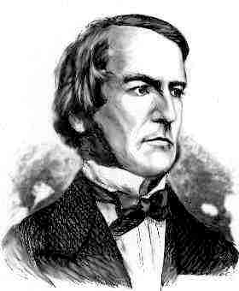
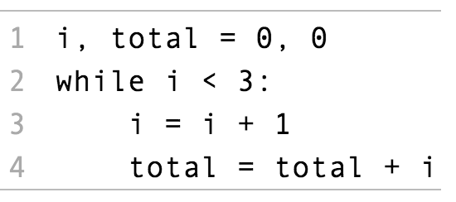
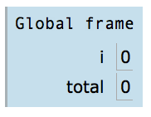
While Statements
(Demo)
1
2
3
1
3
6
Execution Rule for While Statements:
George Boole
1. Evaluate the header’s expression.
2. If it is a true value, execute the (whole) suite, then return to step 1.

Slide 5
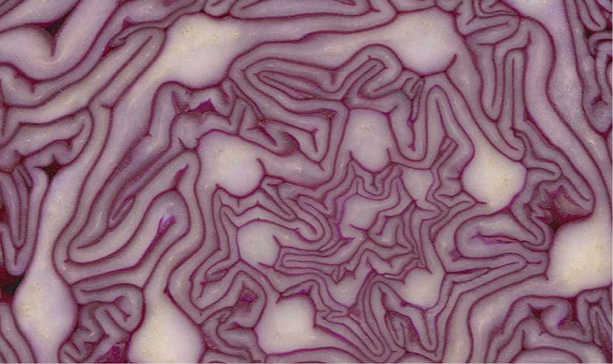
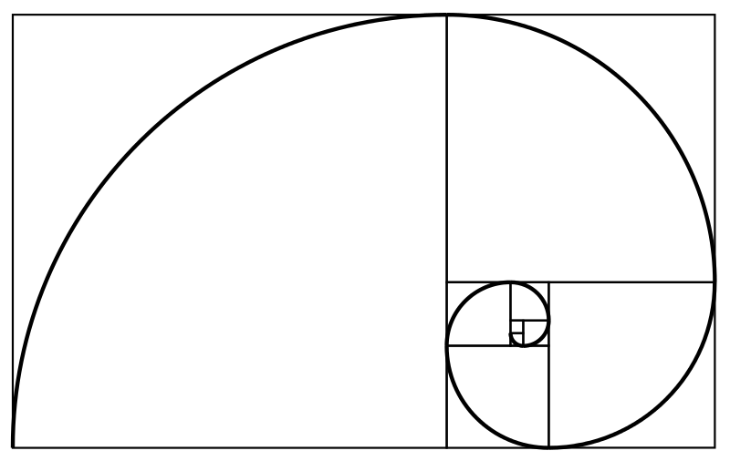
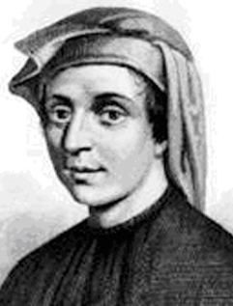
The Fibonacci Sequence
fib
pred
curr
n
5
1
2
3
4
k
5
0, 1, 1, 2, 3, 5, 8, 13, 21, 34, 55, 89, 144, 233, 377, 610, 987
def fib(n):
"""Compute the nth Fibonacci number, for N >= 1."""
pred, curr = 0, 1 # 0th and 1st Fibonacci numbers
k = 1 # curr is the kth Fibonacci number
while k < n:
pred, curr = curr, pred + curr
k = k + 1
return curr
The next Fibonacci number is the sum of the current one and its predecessor

Slide 6
Designing Functions

Slide 7
Describing Functions
def square(x):
"""Return X * X."""
A function's domain is the set of all inputs it might possibly take as arguments.
A function's range is the set of output values it might possibly return.
A pure function's behavior is the relationship it creates between input and output.
x is a number
square returns a non-negative real number
square returns the square of x

Slide 8
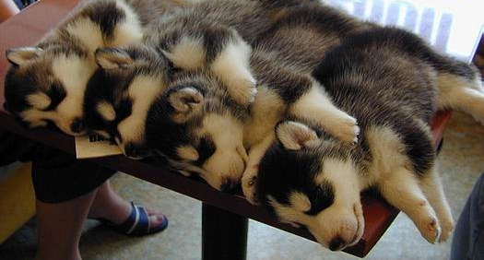
A Guide to Designing Function… Generalization!
Give each function exactly one job, but make it apply to many related situations
>>> round(1.23)
1
>>> round(1.23, 1)
1.2
>>> round(1.23, 0)
1
>>> round(1.23, 5)
1.23
Don’t repeat yourself (DRY). Implement a process just once, but execute it many times.

Slide 9
Generalization

Slide 10
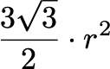
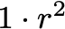
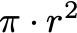
Generalizing Patterns with Arguments
Regular geometric shapes relate length and area.
Shape:
Area:
Finding common structure allows for shared implementation
(Demo1)

Slide 11
Higher-Order Functions

Slide 12
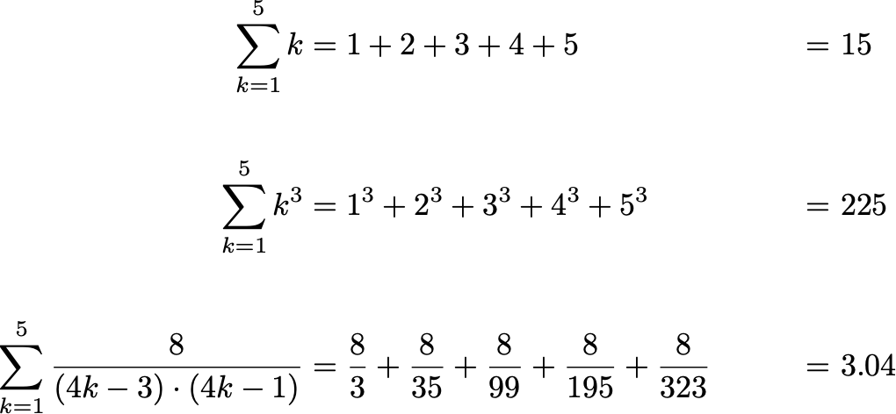
Generalizing Over Computational Processes
The common structure among functions may be a computational process, rather than a number.
(Demo2)

Slide 13
Summation Example
Function of a single argument (not called "term")
A formal parameter that will be bound to a function
The cube function is passed as an argument value
0 + 1 + 8 + 27 + 64 + 125
The function bound to term gets called here

Slide 14
Functions as Return Values
(Demo3)

Slide 15
Locally Defined Functions
Functions defined within other function bodies are bound to names in a local frame
A function that returns a function
The name add_three is bound to a function
A def statement within another def statement
Can refer to names in the enclosing function

Slide 16
Call Expressions as Operator Expressions
An expression that evaluates to a function
An expression that evaluates to its argument
Operator
Operand
3
make_adder(1) ( 2 )
func adder(k)
2
make_adder(1)
func make_adder(n)
1
make_adder( n ):
func adder(k)

Slide 17
Lambda Expressions
λ
(Demo4)

Slide 18
Lambda Expressions
An expression: this one evaluates to a number
>>> x = 10
>>> square = x * x
Also an expression: evaluates to a function
>>> square = lambda x: x * x
Important: No "return" keyword!
A function
with formal parameter x
that returns the value of "x * x"
>>> square(4)
16
Must be a single expression
Lambda expressions are not common in Python, but important in general
Lambda expressions in Python cannot contain statements at all!

Slide 19

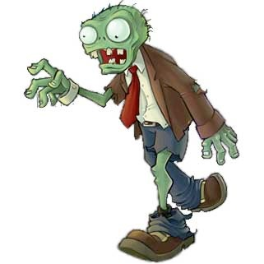
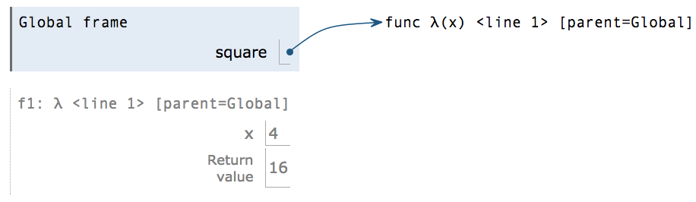
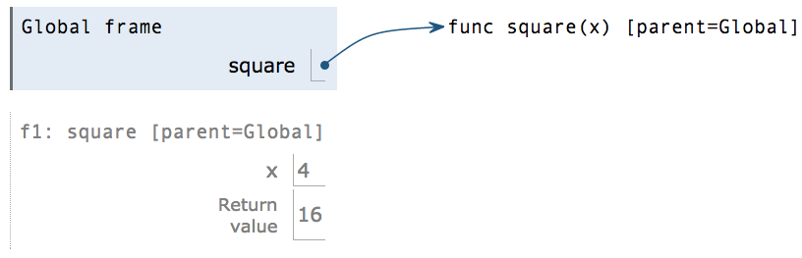
Lambda Expressions Versus Def Statements
square = lambda x: x * x
VS
def square(x):
return x * x
Both create a function with the same domain, range, and behavior.
Both bind that function to the name square.
Only the def statement gives the function an intrinsic name, which shows up in environment diagrams but doesn't affect execution (unless the function is printed).
The Greek letter lambda

